Slide 1

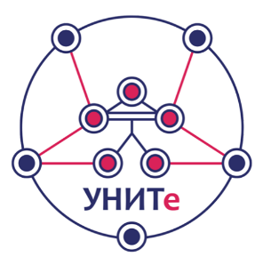
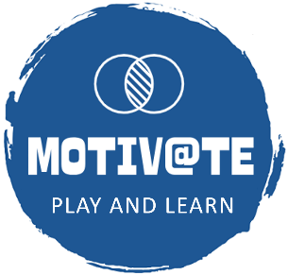

Enhanced Video Games for STEM Education
Dessislava Vassileva
7th Int. Scientific Conf. "Innovative STEM Education“ (STEMedu-2025)
Veliko Tarnovo, Bulgaria
October 06, 2025

Slide 2
Overview
Enhanced video games merge entertainment with pedagogy
Powerful tools for technology-supported STEM education
Leverage emerging technologies: VR, AR, and adaptive AI
Create immersive, interactive, student-centered experiences
Transform abstract concepts into accessible learning

Slide 3
The Power of Game-Based Learning
Increases student engagement and motivation
Promotes active learning over passive consumption
Provides immediate feedback and iterative improvement
Enables safe experimentation and failure
Bridges theory with practical application
Example:
Minecraft Education Edition - 180M+ students worldwide use it for collaborative problem-solving in science, math, and engineering

Slide 4
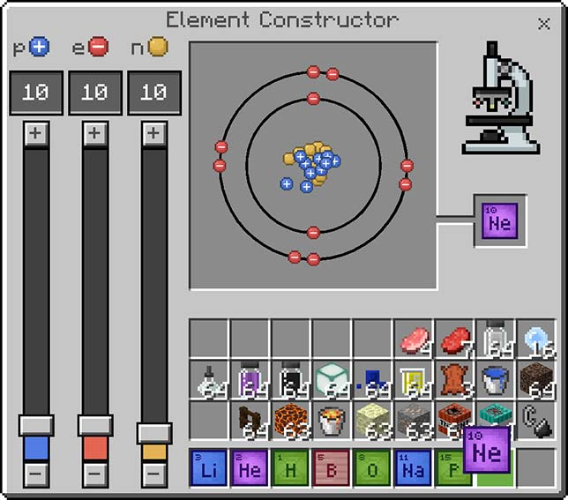
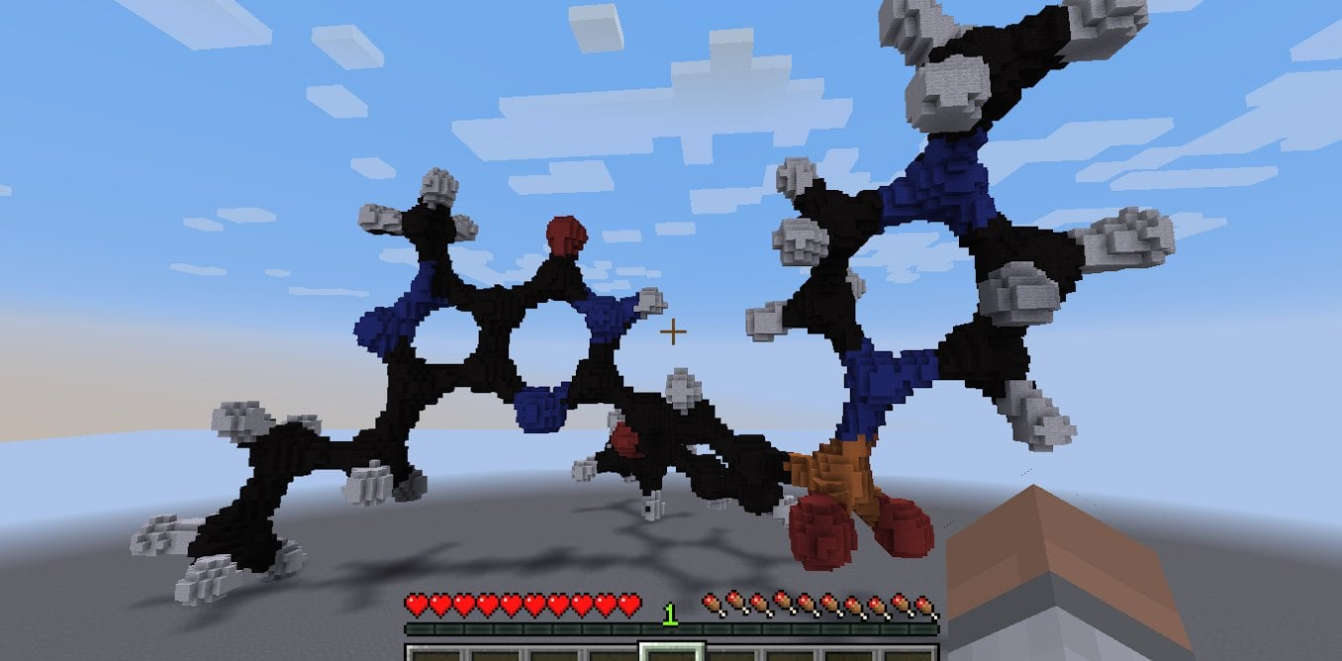
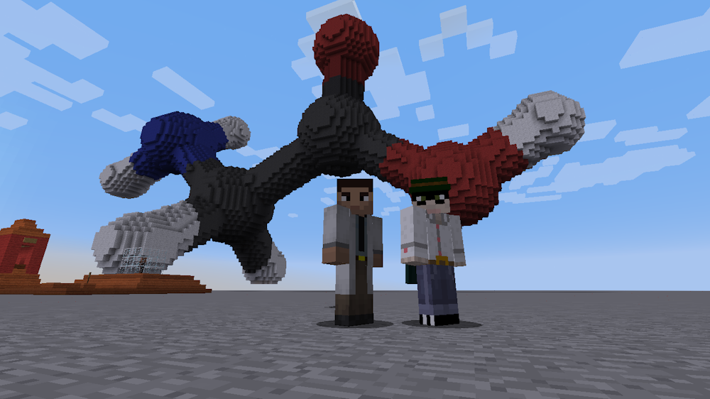
Minecraft Education Edition
Students building molecular structures and exploring chemistry concepts in Minecraft

Slide 5
What Makes Games 'Enhanced'?
Integration of Virtual Reality (VR) technologies
Augmented Reality (AR) overlays on real environments
Adaptive personalization using AI algorithms
Real-time data analytics and progress tracking
Multi-sensory immersive experiences

Slide 6
Virtual Reality in STEM Education
Fully immersive 3D learning environments
Explore microscopic worlds or vast cosmic structures
Manipulate 3D molecular models and engineering designs
Conduct virtual laboratory experiments safely
Experience spatial reasoning in mathematics and physics
Examples:
Labster - VR biology/chemistry labs used by 400+ universities
ENGAGE - Virtual classrooms for collaborative STEM learning
Titans of Space - Explore solar system in VR

Slide 7
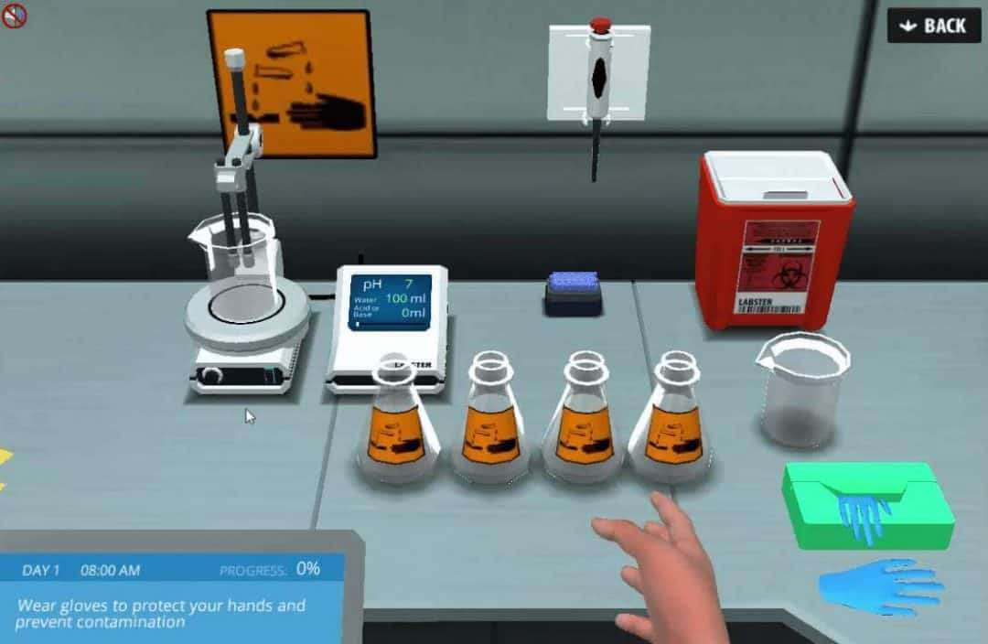
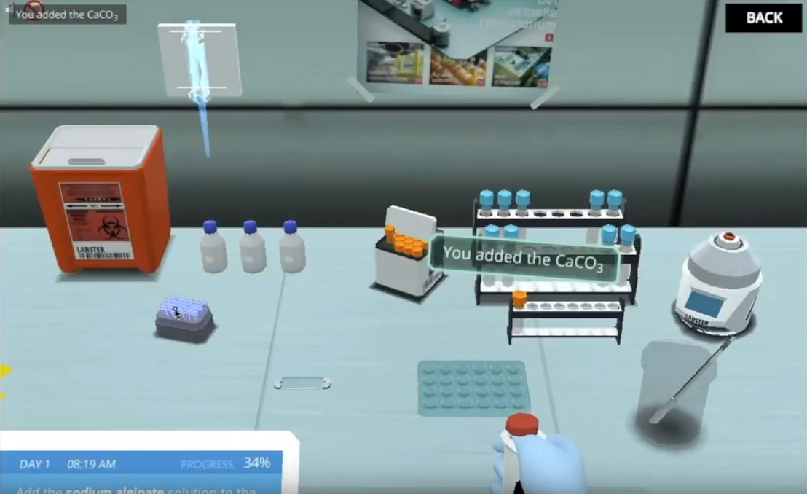
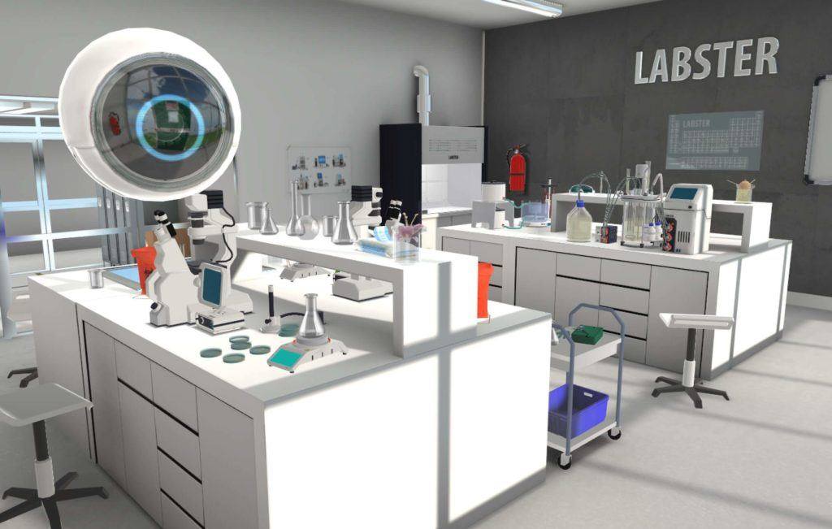
Labster VR Laboratory
Virtual chemistry lab where students perform experiments safely

Slide 8
Augmented Reality Applications
Overlay digital information on physical objects
Visualize invisible phenomena (magnetic fields, forces)
Interactive 3D models in classroom settings
Location-based learning experiences
Blends real-world context with digital enhancements
Examples:
Merge Cube - Hold 3D objects in your hands
Elements 4D - Combine element blocks to see chemical reactions
SkyView - Point at sky to identify stars/planets

Slide 9
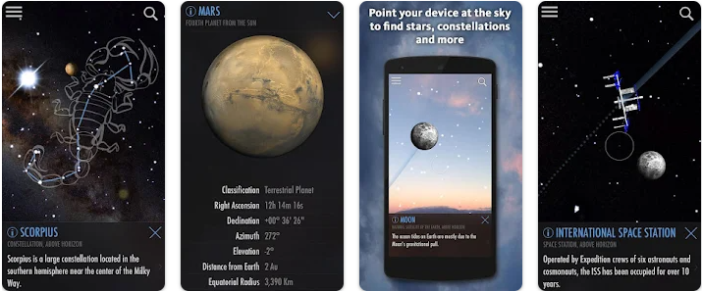
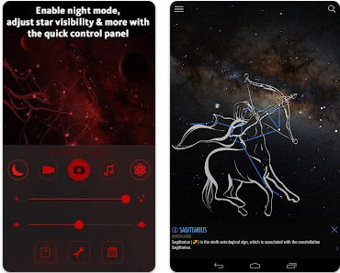
SkyView AR Experience
Intuitive stargazing app that uses your camera to precisely spot and identify celestial objects in sky, day or night

Slide 10
Adaptive Personalization
AI-driven difficulty adjustment based on performance
Personalized learning paths for individual students
Real-time scaffolding and support mechanisms
Learning style adaptation (visual, kinesthetic, logical)
Targeted intervention for struggling concepts
Examples:
Rush for gold – Video game for recognizing learning and playing style
Prodigy Math - Adjusts to each student's level in real-time
STRAMAG – Adaptive game for strategic management in technological entrepreneurship

Slide 11
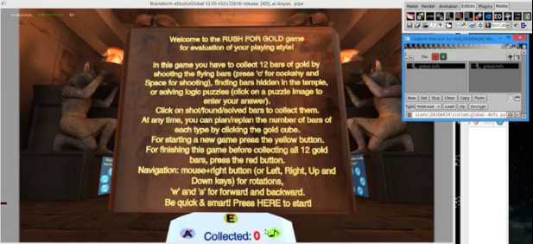
Rush for gold
Initial game view

Slide 12
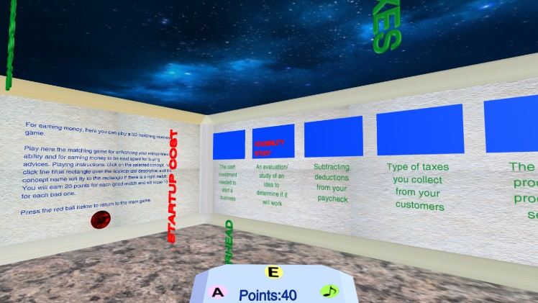
STRAMAG
Inside one of the matching games in the quiz room

Slide 13
Dynamic Visualization of Abstract Concepts
Make invisible processes visible (electron flow, reactions)
Interactive manipulation of mathematical functions
Simulate complex systems (ecosystems, circuits, climate)
Time manipulation for slow/fast phenomena
Multiple perspective viewing of 3D structures
Examples:
PhET Interactive Simulations - 150+ science/math sims by University of Colorado
GeoGebra - Dynamic mathematics visualization tool

Slide 14
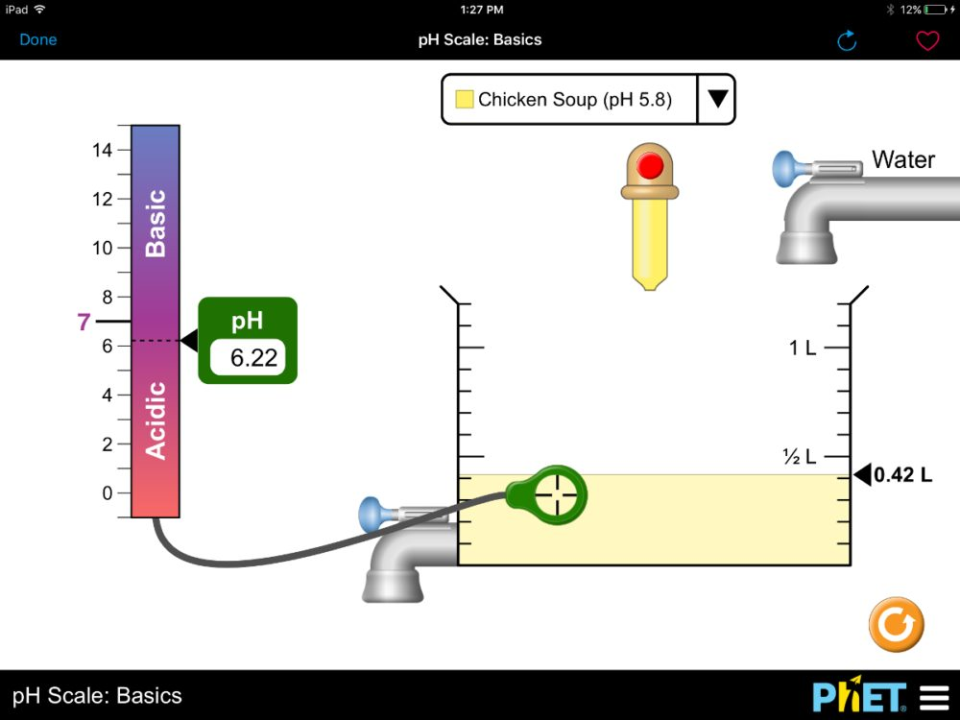
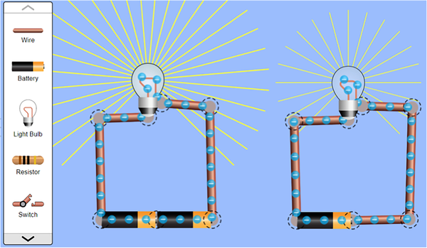
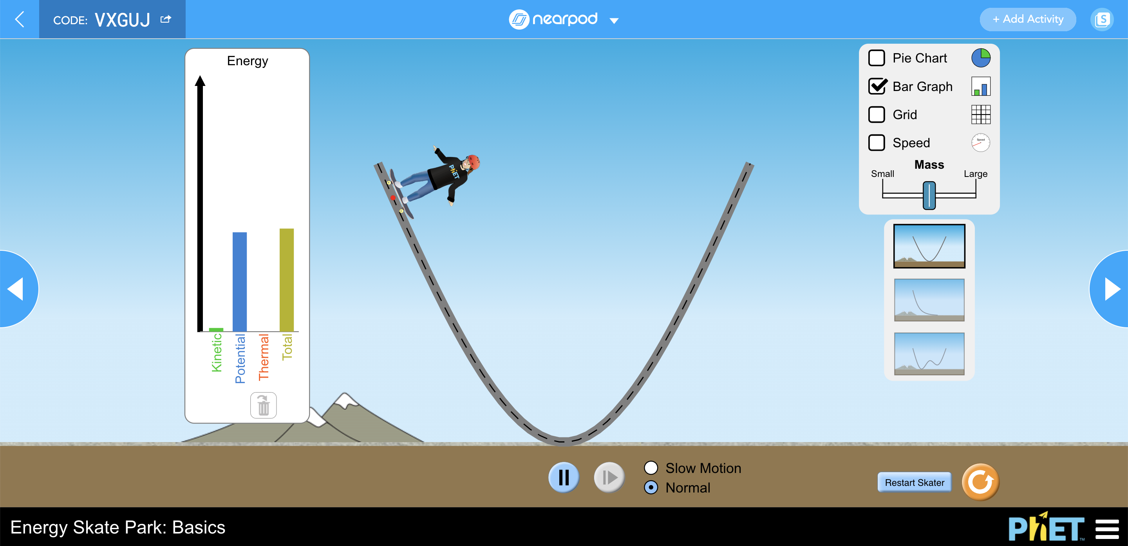
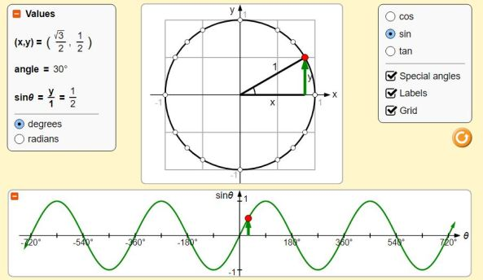
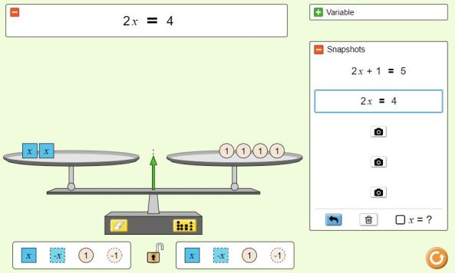
PhET Interactive Simulations
PhET - research-based simulations cover physics, chemistry, biology, earth science, and mathematics

Slide 15
STEM Applications: Mathematics
Geometric constructions in 3D space
Visualization of calculus concepts
Interactive graphing and functions
Probability simulations
Algorithmic thinking games
Examples:
DragonBox - Algebra through puzzle games
Desmos - Interactive graphing calculator
Euclidea - Geometric construction puzzles
Mathigon - Interactive textbook with manipulatives

Slide 16
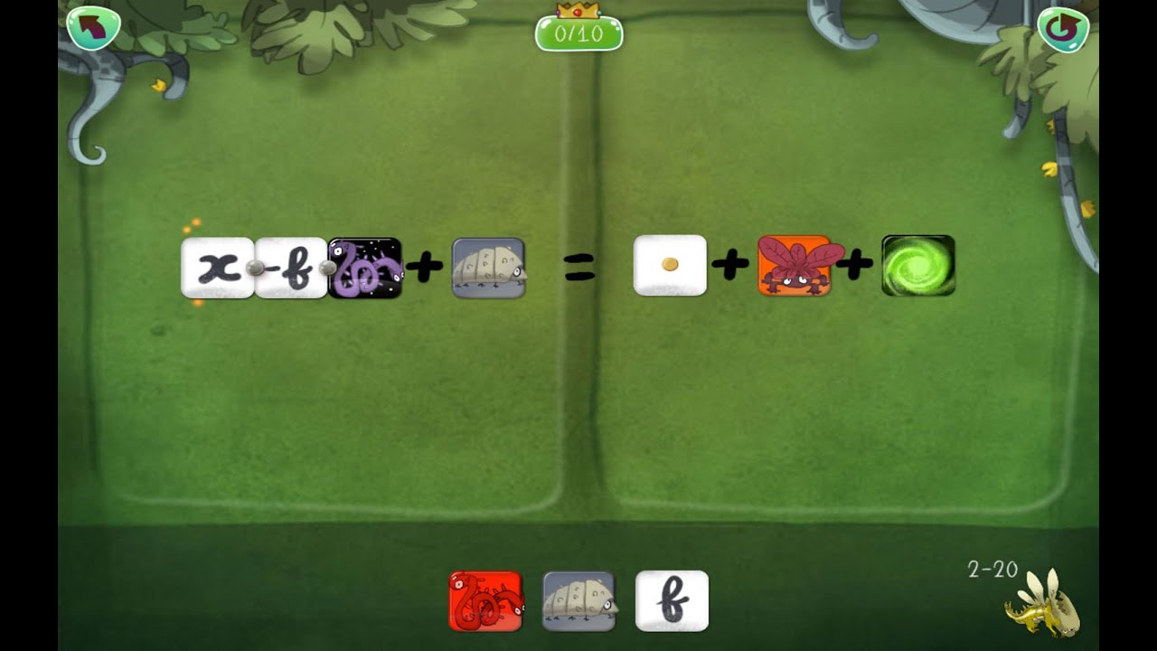
DragonBox Algebra
DragonBox - algebra as a puzzle game

Slide 17
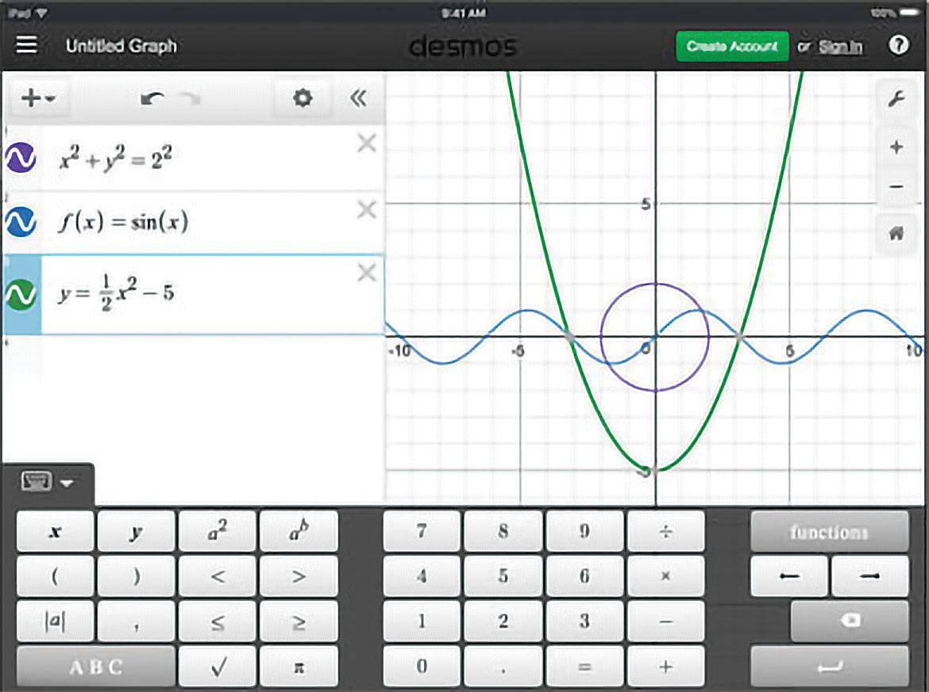
Desmos Graphing Calculator
Multiple curves in different colors overlapping

Slide 18
STEM Applications: Science
Virtual laboratory experiments
Molecular modeling
Physics simulations
Biological system exploration
Astronomy experiences
Examples:
Foldit - Protein folding puzzles (real research)
Universe Sandbox - Physics-based space simulator
Chemist VR - Virtual chemistry lab
The Body VR - Journey inside human body

Slide 19
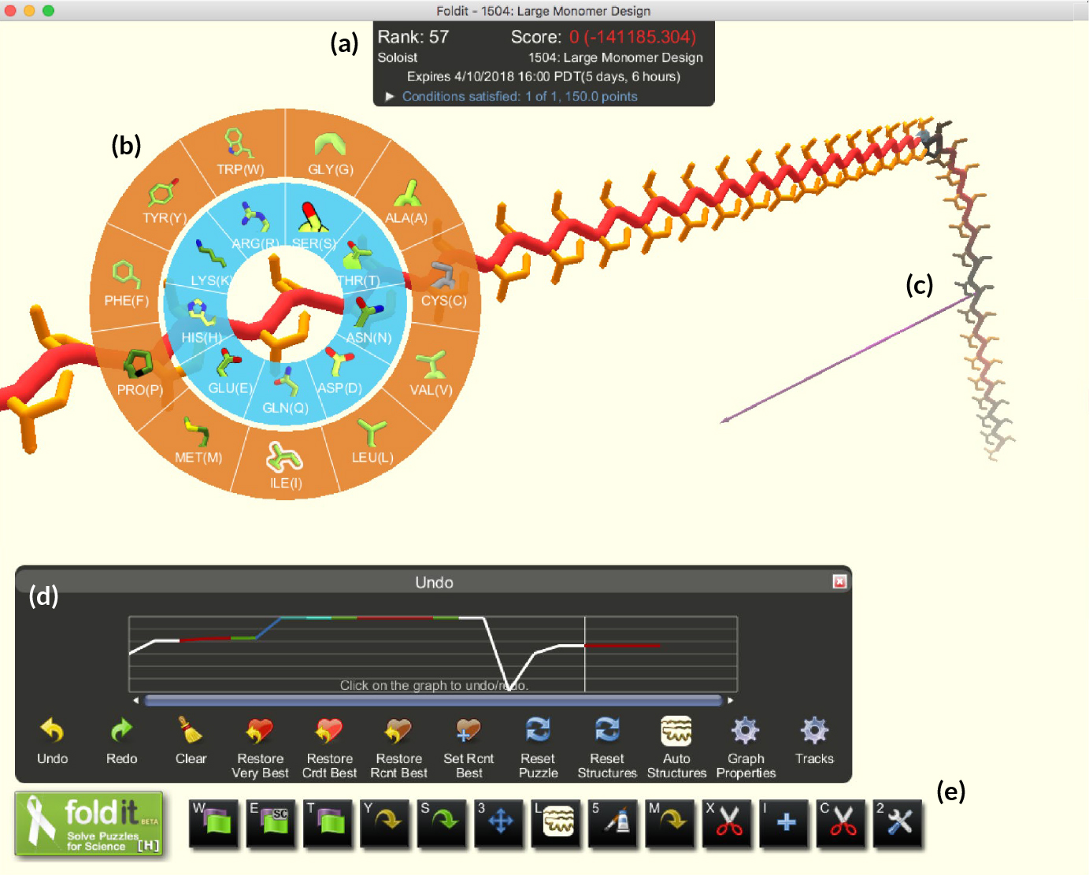
Foldit - Protein Folding Game
Players try to find the most stable protein configurations

Slide 20
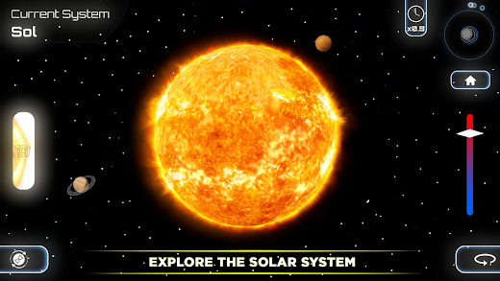
Universe Sandbox
A physics-based space simulator - change Earth's mass and watch orbital mechanics respond in real-time

Slide 21
STEM Applications: Technology & Engineering
Circuit design and programming
3D CAD and prototyping
Robotics simulation
Computational thinking
Engineering problem-solving
Examples:
CodeCombat - Learn coding through RPG gameplay
Kerbal Space Program - Rocket design & orbital mechanics
CircuitVerse - Digital circuit simulator
Tinkercad - 3D design and circuits

Slide 22
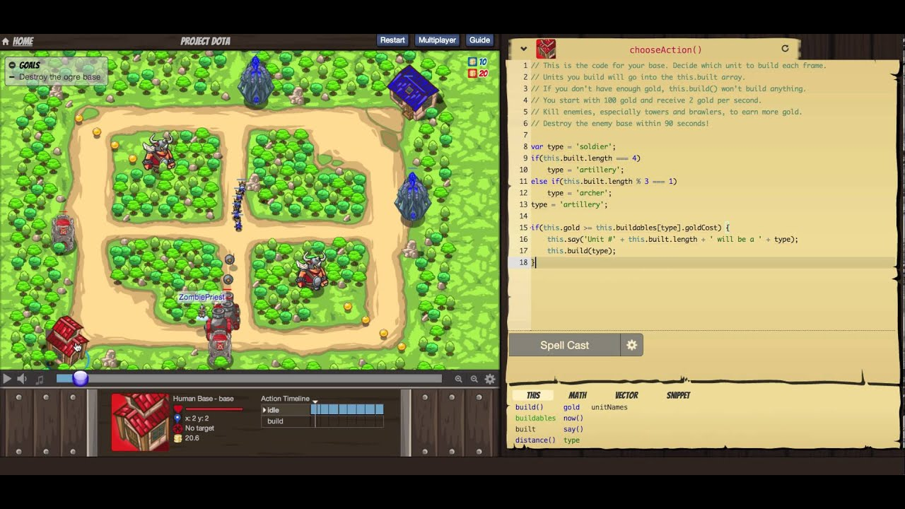
CodeCombat
Split-screen interface: game view on left, code editor on right

Slide 23
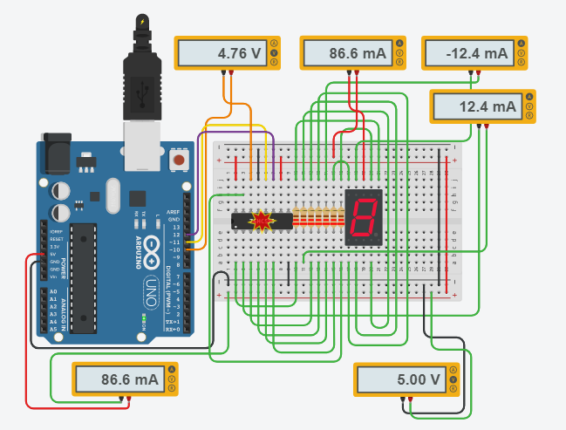
Tinkercad
Tinkercad is web-based, and accessible—students design 3D objects and test circuits virtually

Slide 24
Technological Requirements: Hardware
VR headsets (Oculus Quest, HTC Vive, PlayStation VR)
AR-capable devices (tablets, smartphones, HoloLens)
High-performance computers or gaming consoles
Motion controllers and haptic feedback devices
Adequate network infrastructure for cloud processing

Slide 25
Technological Requirements: Software
Educational game platforms and content libraries
Learning management system integration
Analytics and assessment tools
Content creation and customization software
Cross-platform compatibility considerations

Slide 26
Integration Strategies: Curriculum Design
Align games with learning objectives and standards
Blend game-based and traditional instruction
Design pre- and post-game activities
Create assessment rubrics for game performance
Sequence games within broader unit plans

Slide 27
Integration Strategies: Classroom Implementation
Teacher training and professional development
Establish clear learning goals before gameplay
Facilitate reflection and discussion after sessions
Balance individual and collaborative gameplay
Manage classroom technology and time effectively

Slide 28
Cognitive and Affective Outcomes
Enhanced spatial reasoning and visualization skills
Improved retention through experiential learning
Reduced STEM anxiety and increased confidence
Development of metacognitive strategies
Positive attitudes toward STEM subjects and careers

Slide 29
Considerations & Solutions
Hardware Costs
Start small with mobile AR, seek grants, share resources across classes
Teacher Training
Peer mentoring programs, vendor workshops, gradual implementation
Balance & Distraction
Clear learning objectives, structured reflection time, gameplay limits
Content Suitability
Evaluate alignment with standards, pilot test before full deployment

Slide 30
Future Directions
AI-Powered Personal Tutors
Intelligent agents that understand student emotions, provide natural language explanations, and adapt in real-time
Metaverse Learning Spaces
Persistent virtual campuses where students collaborate globally on STEM projects in shared immersive environments
Brain-Computer Interfaces
Direct neural feedback for enhanced spatial reasoning and accelerated skill acquisition in mathematics and physics
Collective Intelligence Games
Massively multiplayer STEM challenges where thousands of students solve real-world problems together
Procedural Content Generation
AI creates unlimited personalized problems, scenarios, and challenges tailored to each student's learning edge
Predictive Learning Analytics
Machine learning predicts struggling concepts before failure occurs, enabling proactive intervention

Slide 31
Conclusions
Enhanced video games are powerful tool for STEM learning
They foster engagement, creativity, and deeper understanding
Integration of VR, AR, and AI turns abstract STEM concepts into hands-on experiences
With proper design and curriculum alignment, games become not distractions, but essential educational tools
Challenges exist but solutions are emerging

Slide 32
Acknowledgements
This research was partially supported by the following projects:
Modeling intelligent tools for adaptive and personalized educational STEM video games (MOTIVATE) – 2024-2026
Universities for Science, Informatics and Technologies in eSociety (UNITe) – 2025-2029
Thank you for your attention!

Slide 33


